Slide 1
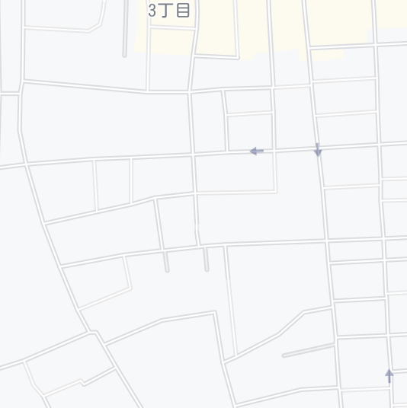
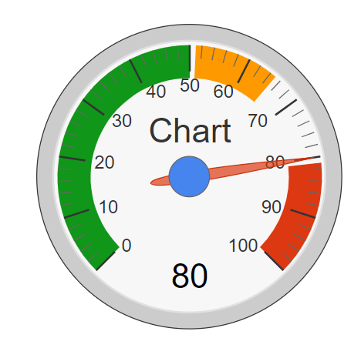

Technical Details
Domain modeling
Shelter: sid, name, address, lat, lng, capacity, isActive, manager
Citizen: cid, name, email, password, home address, # of families
Check-In: id, cid, sid, check-in datetime, check-out datetime
Search shelters by distance
Obtain current (x,y) from GPS
Find shelters S(lng, lat) such that ; d(lng, lat) = 6371 * acos (cos(rad(y)) * cos(rad(lat)) * cos(rad(lng) – rad(x)) + sin(rad(y))*sin(rad(lat))) <= D
Calculate density of shelter
CheckIn(S): # of families currently checked in S
Capacity(S): Max # of families S can accommodate
Density(S) = CheckIn(S) / Capacity(S)
Shelter
1
0..*
Check-In
Citizen
0..*
1
D
Notes:
I will talk about technical details.
First, Domain modeling defines data structure and relationships of Shelter Navi. The main entities are shelter and citizen and check-in.
Each entity as these data items and check-in records which citizen is in which shelter.
Second, How does the system search shelters by distance?
System obtains current (x,y) from GPS and find shelters S(lng,lat) such that this equation is satisfied.
This equation searches the shelters whose coordinates are nearer than distance(D) form current position (x,y)
Third, how does the system calculate density of shelter?
CheckIn(S) represents the number of families currently checked in S.
Capacity(S) represents the max number of families S can accommodate.
Density(S) equal CheckIn(S) divided by Capacity(S).
///////////
(Shelter’s data is shelter-id, name, address, latitude, longitude, isActive, and manager.
Citizen’s data is shelter-id, name, email, password, home address and number of families.
Check-in‘s data is id, shelter-id, citizen-id, check-in datetime and check-out datetime.)

Slide 2
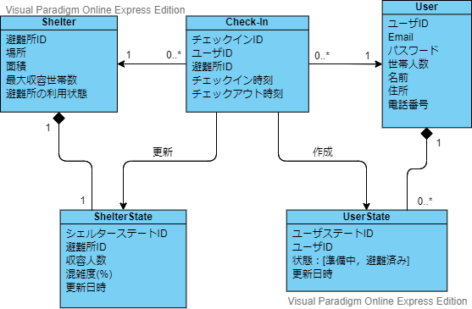
ドメインモデリング
Notes:
ここでどのようなエンティティがあるのか，それぞれのエンティティがどのように結びつき，役割を果たすのか簡単に説明

Slide 3
避難所エンティティ

Slide 4
避難所エンティティ
避難所に関する静的な情報を取り扱う
ID
避難所の識別子
名称
検索結果、避難所の検索
住所
検索結果、避難所の検索
緯度、経度
地図上へ反映させるための位置情報
面積
最大収容世帯数の計算
最大収容世帯数
混雑状況の計算
利用状態
現在利用可能かどうかの表示

Slide 5
ユーザエンティティ
Notes:
I will talk about technical details.
First, Domain modeling defines data structure and relationships of Shelter Navi. The main entities are shelter and citizen and check-in.
Each entity as these data items and check-in records which citizen is in which shelter.
Second, How does the system search shelters by distance?
System obtains current (x,y) from GPS and find shelters S(lng,lat) such that this equation is satisfied.
This equation searches the shelters whose coordinates are nearer than distance(D) form current position (x,y)
Third, how does the system calculate density of shelter?
CheckIn(S) represents the number of families currently checked in S.
Capacity(S) represents the max number of families S can accommodate.
Density(S) equal CheckIn(S) divided by Capacity(S).
///////////
(Shelter’s data is shelter-id, name, address, latitude, longitude, isActive, and manager.
Citizen’s data is shelter-id, name, email, password, home address and number of families.
Check-in‘s data is id, shelter-id, citizen-id, check-in datetime and check-out datetime.)

Slide 6
ユーザエンティティ

Slide 7
チェックインエンティティ
Notes:
I will talk about technical details.
First, Domain modeling defines data structure and relationships of Shelter Navi. The main entities are shelter and citizen and check-in.
Each entity as these data items and check-in records which citizen is in which shelter.
Second, How does the system search shelters by distance?
System obtains current (x,y) from GPS and find shelters S(lng,lat) such that this equation is satisfied.
This equation searches the shelters whose coordinates are nearer than distance(D) form current position (x,y)
Third, how does the system calculate density of shelter?
CheckIn(S) represents the number of families currently checked in S.
Capacity(S) represents the max number of families S can accommodate.
Density(S) equal CheckIn(S) divided by Capacity(S).
///////////
(Shelter’s data is shelter-id, name, address, latitude, longitude, isActive, and manager.
Citizen’s data is shelter-id, name, email, password, home address and number of families.
Check-in‘s data is id, shelter-id, citizen-id, check-in datetime and check-out datetime.)

Slide 8
チェックインエンティティ
ここの説明でSearchShelterByDistance（）の説明もする？

Slide 9
避難所の状態
Notes:
I will talk about technical details.
First, Domain modeling defines data structure and relationships of Shelter Navi. The main entities are shelter and citizen and check-in.
Each entity as these data items and check-in records which citizen is in which shelter.
Second, How does the system search shelters by distance?
System obtains current (x,y) from GPS and find shelters S(lng,lat) such that this equation is satisfied.
This equation searches the shelters whose coordinates are nearer than distance(D) form current position (x,y)
Third, how does the system calculate density of shelter?
CheckIn(S) represents the number of families currently checked in S.
Capacity(S) represents the max number of families S can accommodate.
Density(S) equal CheckIn(S) divided by Capacity(S).
///////////
(Shelter’s data is shelter-id, name, address, latitude, longitude, isActive, and manager.
Citizen’s data is shelter-id, name, email, password, home address and number of families.
Check-in‘s data is id, shelter-id, citizen-id, check-in datetime and check-out datetime.)

Slide 10
避難所の状態

Slide 11
ユーザの状態
Notes:
I will talk about technical details.
First, Domain modeling defines data structure and relationships of Shelter Navi. The main entities are shelter and citizen and check-in.
Each entity as these data items and check-in records which citizen is in which shelter.
Second, How does the system search shelters by distance?
System obtains current (x,y) from GPS and find shelters S(lng,lat) such that this equation is satisfied.
This equation searches the shelters whose coordinates are nearer than distance(D) form current position (x,y)
Third, how does the system calculate density of shelter?
CheckIn(S) represents the number of families currently checked in S.
Capacity(S) represents the max number of families S can accommodate.
Density(S) equal CheckIn(S) divided by Capacity(S).
///////////
(Shelter’s data is shelter-id, name, address, latitude, longitude, isActive, and manager.
Citizen’s data is shelter-id, name, email, password, home address and number of families.
Check-in‘s data is id, shelter-id, citizen-id, check-in datetime and check-out datetime.)

Slide 12
ユーザの状態

Slide 13
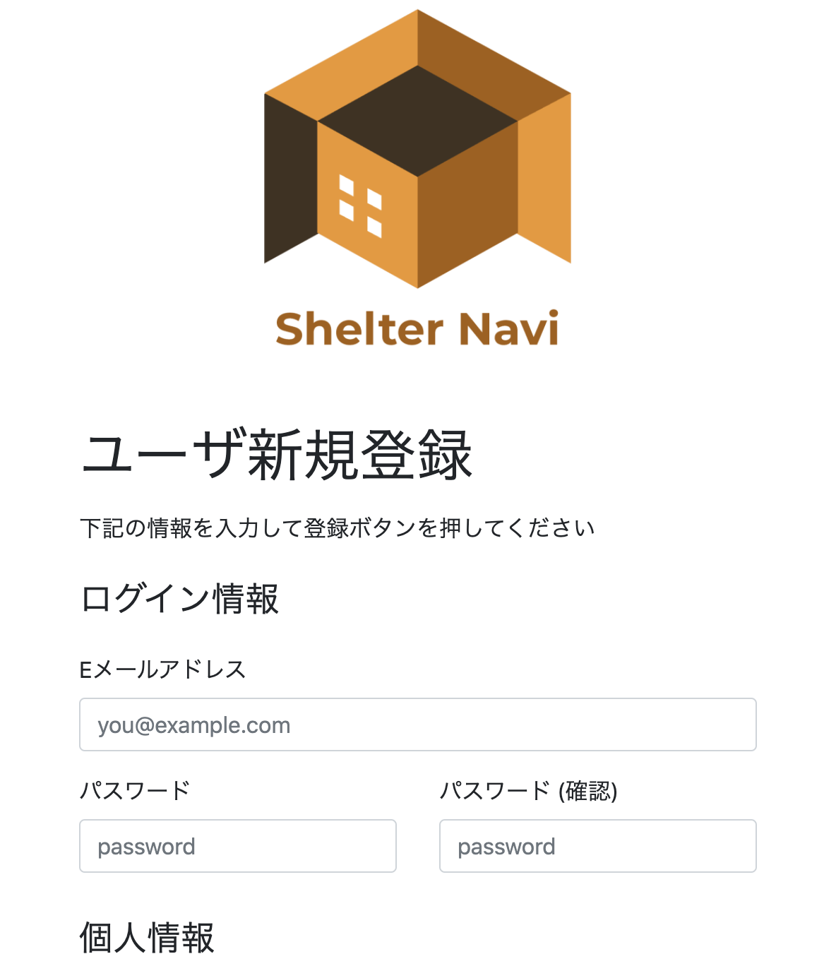
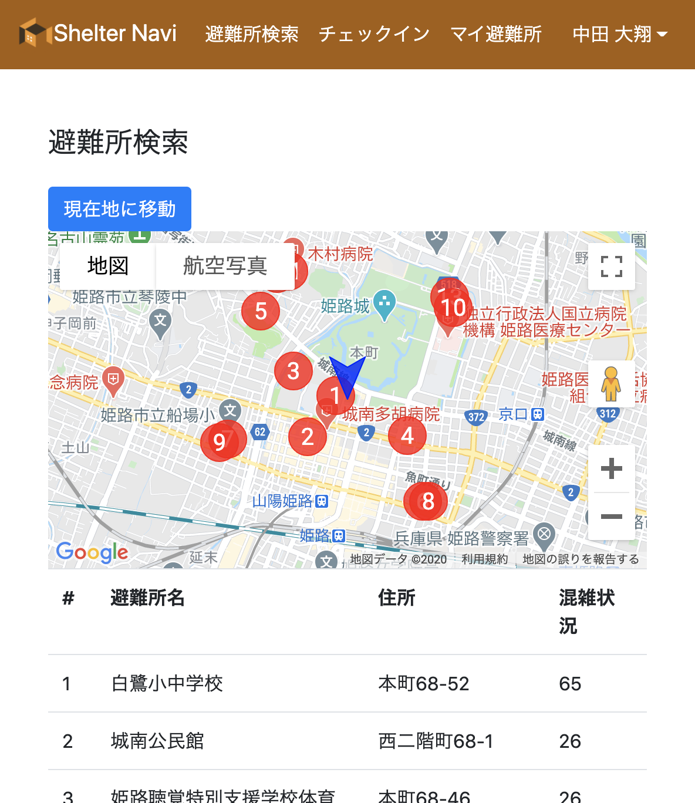
Screenshots of Prototype
We are currently implementing Shelter Navi with open data of Kobe City and Himeji City
Notes:
We are currently implementing Shelter Navi with open data of Kobe City and Himeji City.
These are screenshots of Prototype.
This screen shows user registration screen where the citizen registers personal information.
This screen shows shelter search screen in which the position of each shelter is marked by a circle.
Below shows the shelters name and address and capacity.

Slide 14
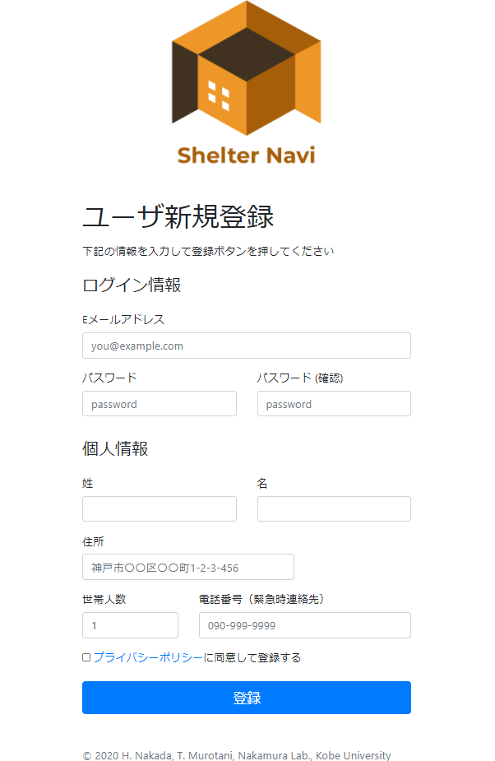
ShelterNaviプロトタイプ
新規登録画面
ログイン情報を入力
メールアドレス
パスワード
個人情報を入力
名前
住所
世帯人数
電話番号
登録ボタンでユーザ登録完了

Slide 15
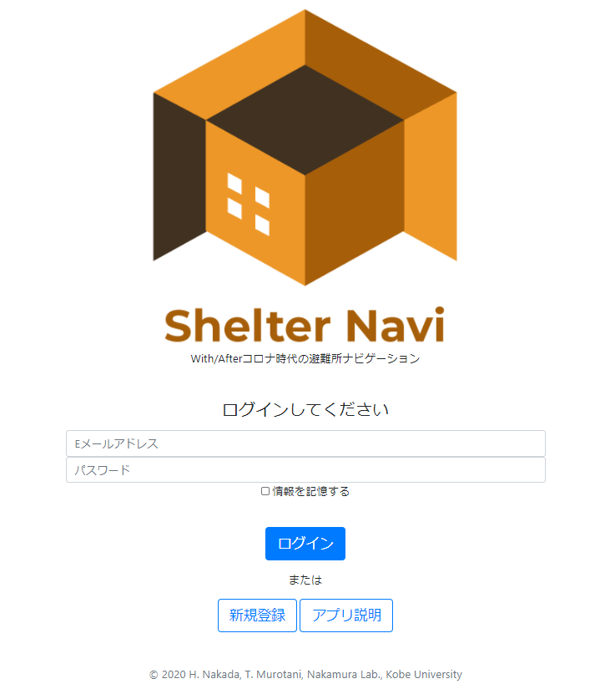
ShelterNaviプロトタイプ
ログイン画面
ログイン情報を入力（認証）
メールアドレス
パスワード
認証により認可されるもの
ユーザ自身の情報へのアクセス
認証、認可の目的
→他ユーザからの閲覧、更新、削除を防止
ログイン後、避難所検索画面へ

Slide 16
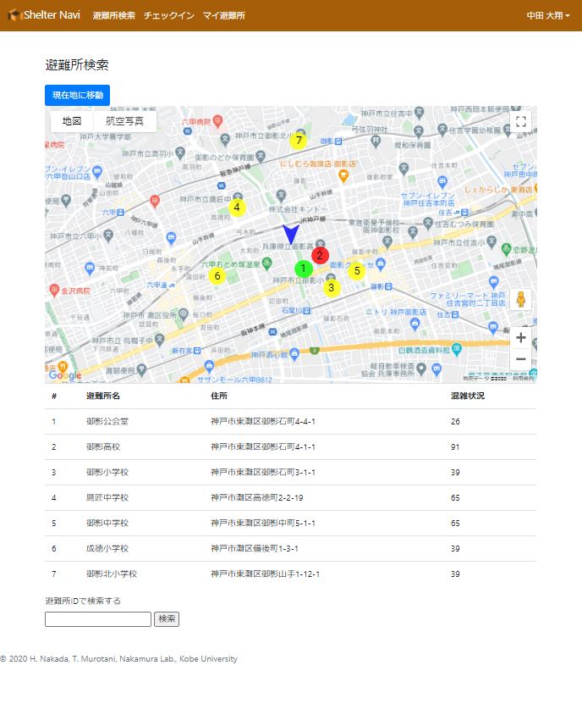
ShelterNaviプロトタイプ
避難所検索画面
画面上部に現在地周辺の地図
青い矢印のマーカーが現在地
赤、黄、緑のピンが避難所
赤：70% ≦ 混雑度
黄：30% ≦ 混雑度 ＜ 70%
緑：混雑度 ＜ 30%
画面下部に避難所の詳細
対応するピンの番号
避難所の名称
避難所の住所
避難所の混雑度
画面最下部で避難所の検索
避難所名、住所の入力で検索
部分一致でも検索可能
Notes:
プロトタイプでの避難所の表示範囲は、ユーザから半径1㎞以内としている

Slide 17
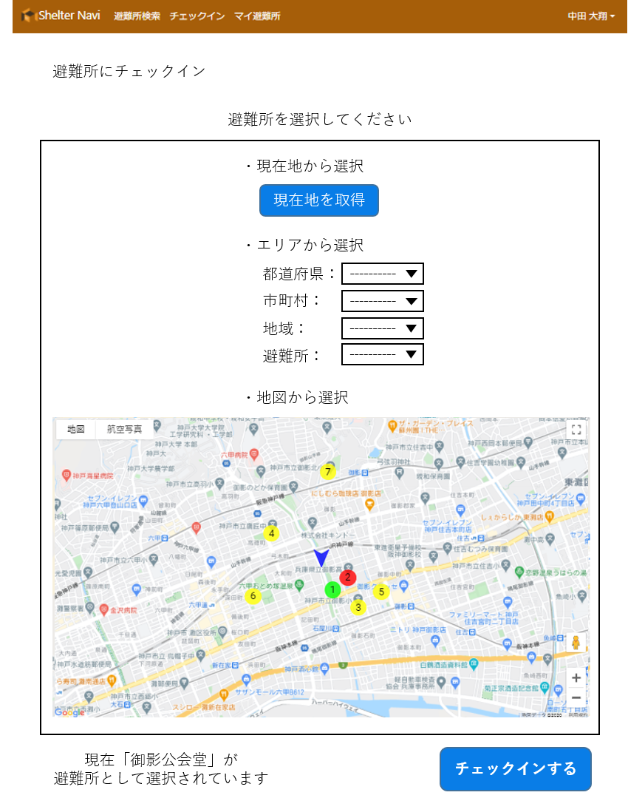
ShelterNaviプロトタイプ
チェックイン画面

Slide 18
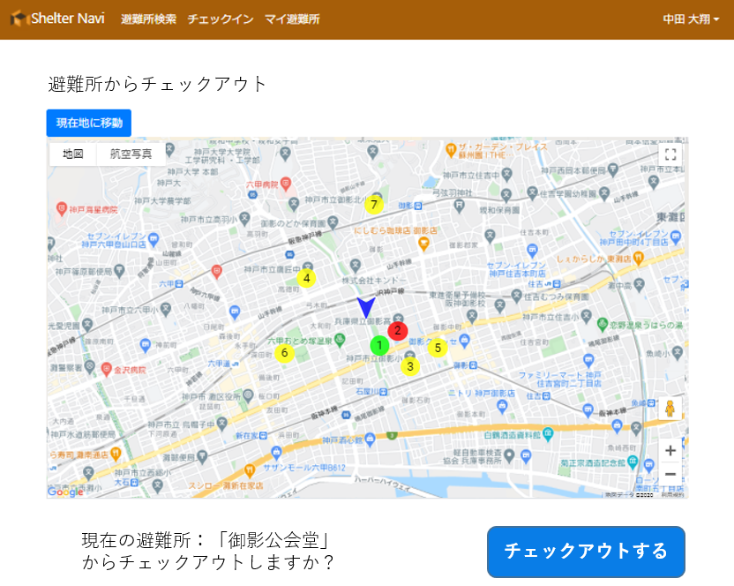
ShelterNaviプロトタイプ
チェックアウト画面

